Slide 1
INTEL 8251 USART (Universal synchronous Asynchronous Receiver/Transmitter)

Slide 2
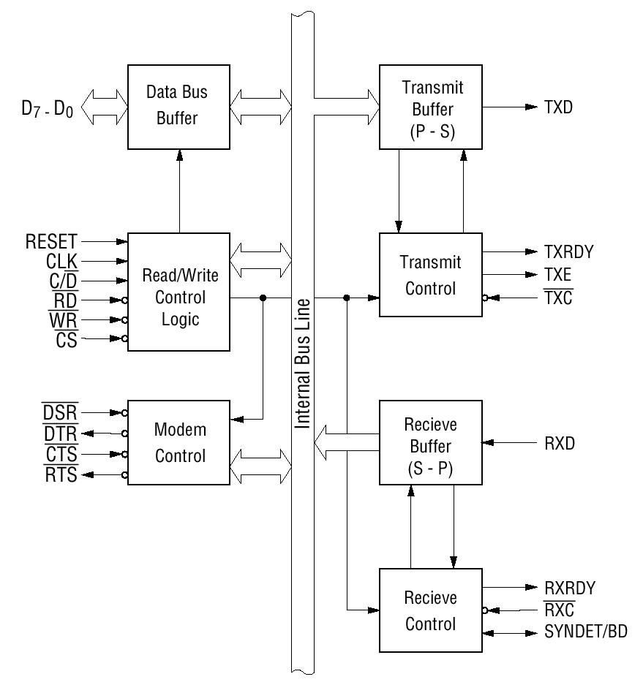
8251 Block Diagram

Slide 3
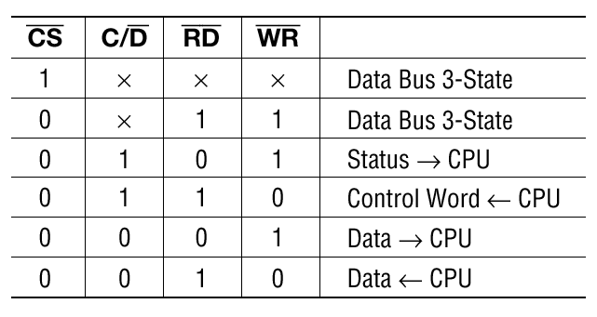
8251 Registers

Slide 4
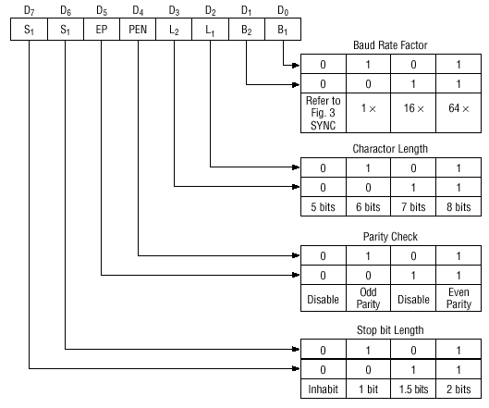
Mode Instruction (Asynchronous)

Slide 5
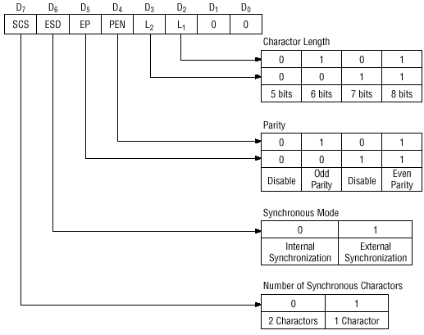
Mode Instruction (Synchronous)

